Slide 1
PPT PRESENTATION ON KARNATAKA TOURIST PLACES
NAME: KAMASANI ROOPA CHANDRA REDDY
SEM:2ND SEM

Slide 2
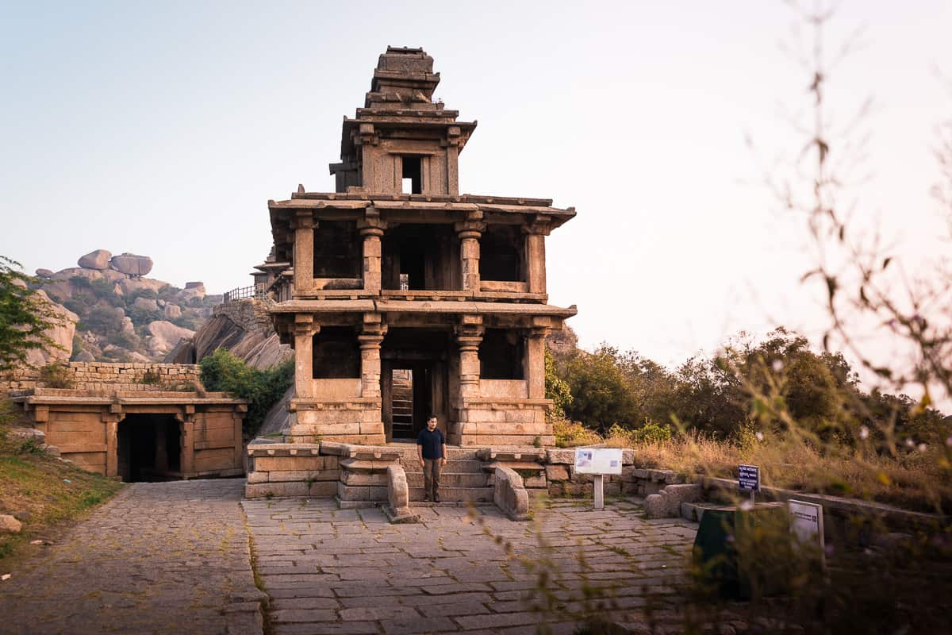
When planning a visit to Karnataka, most first time travellers and tourists visit the south to explore Bangalore, Mysore, Coorg and sometimes even the coastal parts of Karnataka. As a result, north Karnataka happens to be one of the most underrated regions to explore in South India! A unique history, great culinary experience, dry climate and fewer visitors – this makes it very interesting to travel in!

Slide 3
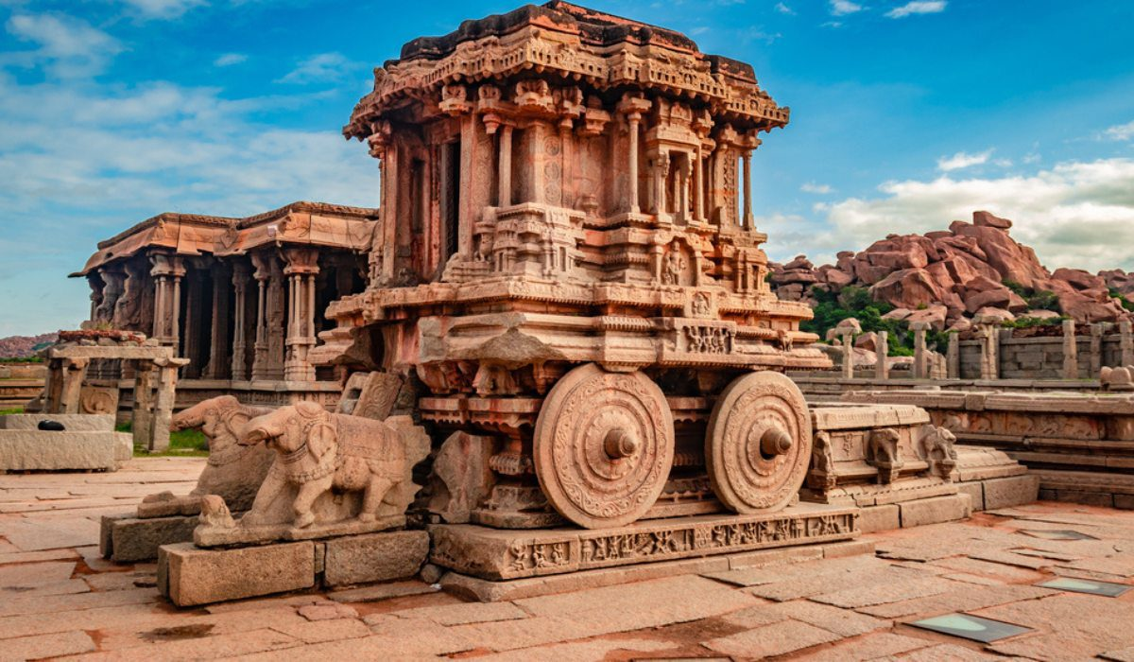
HAMPI
Temple ruins, intricate carvings, a revived bazaar…Hampi’s must-visit spots ooze with an old-world charm and speak of a glorious past that will almost transport you back in time. A UNESCO World Heritage Site, Hampi was the centre of the Vijayanagara Empire in the 4th century. While it has its fair share of adventure activities, what Hampi truly calls for is a serious dose of sightseeing. Home to several treasures, this ancient village in Karnataka promises you a charming time, away from all the bustle of the city. We’ve picked out the best places to visit in Hampi for your next trip there. Go on and explore!

Slide 4
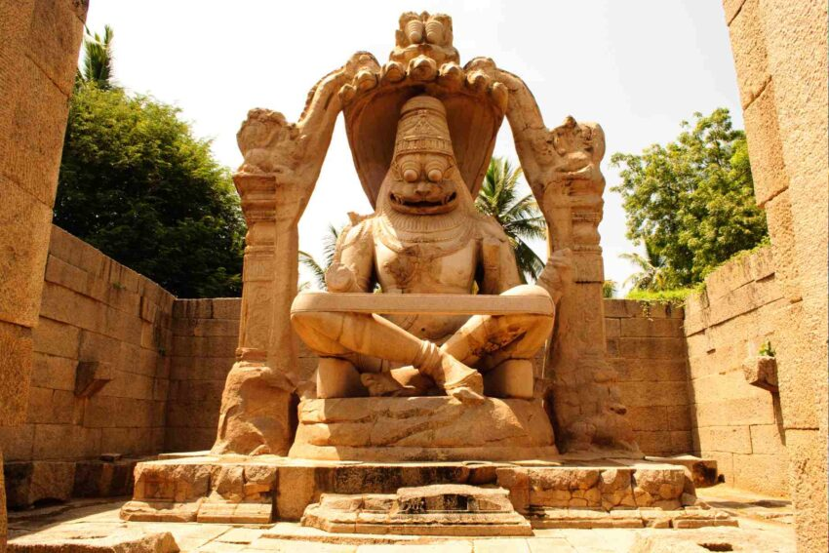
Karnataka is one of the oldest states in India, that showcases the best of cultural and architectural history. From the historical temples to grand forts, these historical places in Karnataka have much to unleash pertaining to their glorious past. In this blog, we will take you on a tour to the 17 remarkable historical places in Karnataka, each having its own charm and significance, that one should visit during their Karnataka tour.

Slide 5
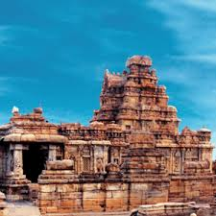
North Karnataka
North Karnataka has monuments that date back to the 5th century. Kannada empires that ruled the Deccan had their capitals here. Badami Chalukyas monuments are located at Pattadakal, Aihole and Badami. Aihole has been called the cradle of Indian architecture and has over 125 temples and monuments built between 450 and 1100 BC. the Vijayanagar empire temples at Vijayanagara are some examples

Slide 6
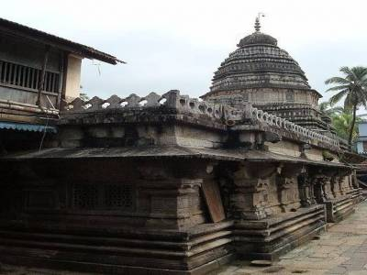
A trip to Hampi is a pre-requisite for anyone nurturing an ardent love for Indian history and architectural marvels from another time.
This rich historical site, which is touted as the world’s largest open-air museum, is a treasure trove of temples, sculptures and endless ruins, dripping with stories of the many changes it witnessed and endured through the ages.

